Slide 1
Sentiment Analysis On Trump related Tweets .
RUKSHAR PARWIN
SOCIAL COMPUTING
ADVISOR: DR. NITIN AGARWAL
30TH APRIL, 2019

Slide 2
Agenda
Project Description
Related Work
Approach
Data and Technologies
Data Set Collection
Sentiment Analysis
Final Outcome
Future Direction/ Reference

Slide 3
Project Description
Objective:
To develop a topic-based social media crawler for Trump related searches
The crawler would search Tweeter Search Network and return what people talk about.
The project intends to:
  Shade some lights to ‘Trump’ related activities on twitter.
  Can be combine with other analysis to understand people perspective.

Slide 4
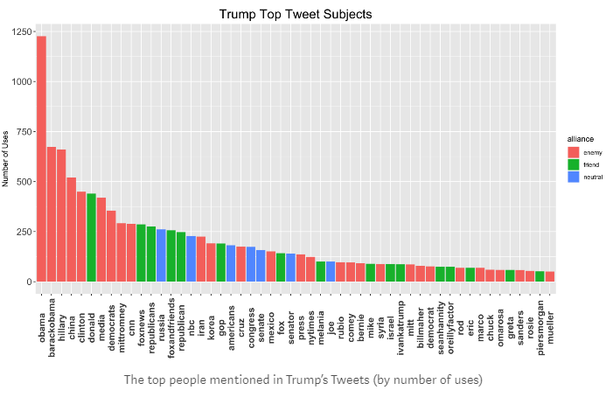
Related Work
Notes:
While researching for this topic, I came across a lot of work that analyses tweets from Trump. For example, this captures Trump top Tweet subjects.

Slide 5
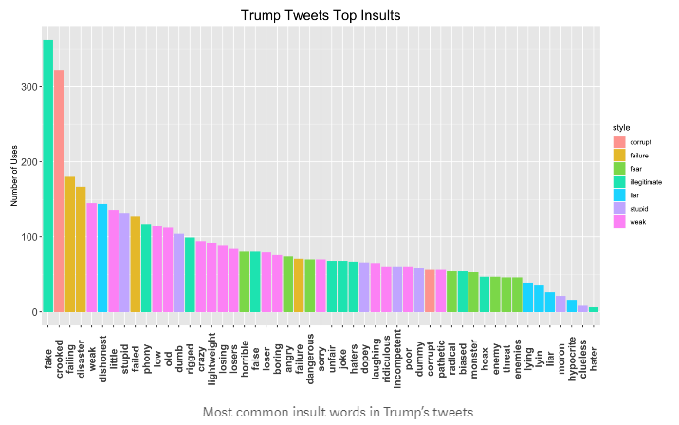
Related Work
Notes:
This captures Trump’s top insults etc.. There are quite a lot of work and these are some very important work. In past generations, it was difficult to figure out what the most powerful person in the world was thinking. We had to rely on press secretaries or political speeches. Now, these thoughts trickle out in a constant stream for all to see. A leader with a constant communication channel to the world is unprecedented.

Slide 6
Approach
Instead of focusing on Tweets either from Trump’s twitter handle @RealDonaldTrump or official @POTUS, I decided to look at tweets that mentions Trump but not from Trump.
One can argue all those followers or tweets are not from real person and can very well be bots.
I agree that it will be pretty difficult to separate these out. I still think a trend on these tweets sentiments would be directionally reliable.

Slide 7
Data and Technologies
Data obtained from – Daily twitter activity using the term ‘Trump’, ‘Donald Trump’, ‘POTUS’
For Crawling: NodeXL
For Sentiment Analysis: Semantria
Dependencies
  Excel
Notes:
NodeXL free version has a limit of 18000 tweets max or data extract for one week activity (whichever comes first). With about 60 Million Trump’s followers on twitter, I was probably able to collect a day or less than day worth of data. So this project is more of a proof of concept.
For sentiment analysis, I tried using couple of different tools; I tried MonkeyLearn app which provided analysis for only about 300 tweets.
I ended up using Semantria, which provides an add-on for excel.

Slide 8
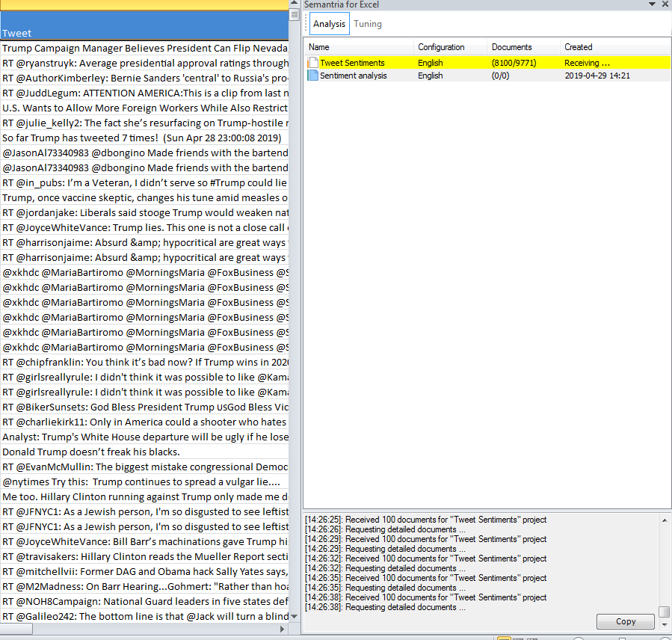
Data Set Collection - NodeXL
Notes:
Here is my data after NodeXL extract. NodeXL extract few different information from twitter including user information, time and place of the tweet, tweet itself and few other variables. For this project, I made sure none of these tweets are either from @RealDonaldTrump or @POTUS account.
I used ‘Tweet’ colum from the excel and ran the sentiment analysis using Sementria.

Slide 9
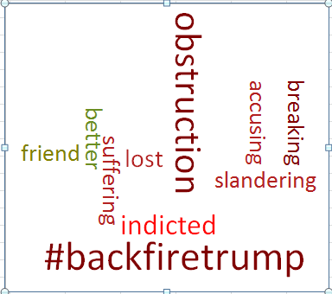
Semantria Sentiment Analysis Result
Notes:
Here is the result set. These are the top 10 phrase mentioned in the data set I collected. The size indicates number of occurrence so #backfiretrump is highest and friend is lowest.

Slide 10
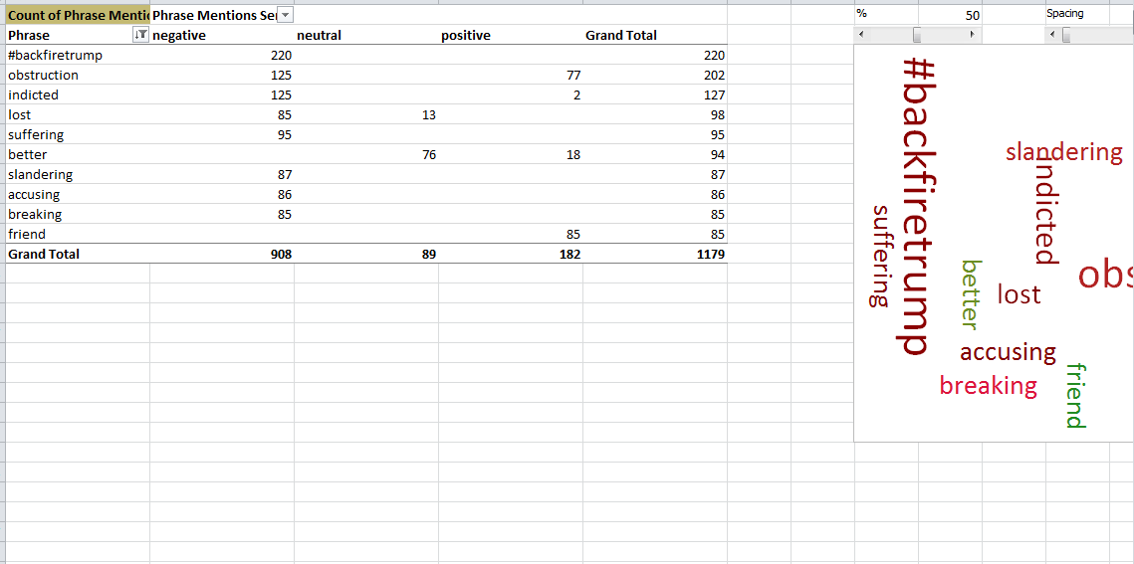
Semantria Sentiment Analysis Result
Notes:
Here is the table after Semantria analysis completes on all the tweets. This table classifies each of these phrases in either negative, neutral, or positive bucket.

Slide 11
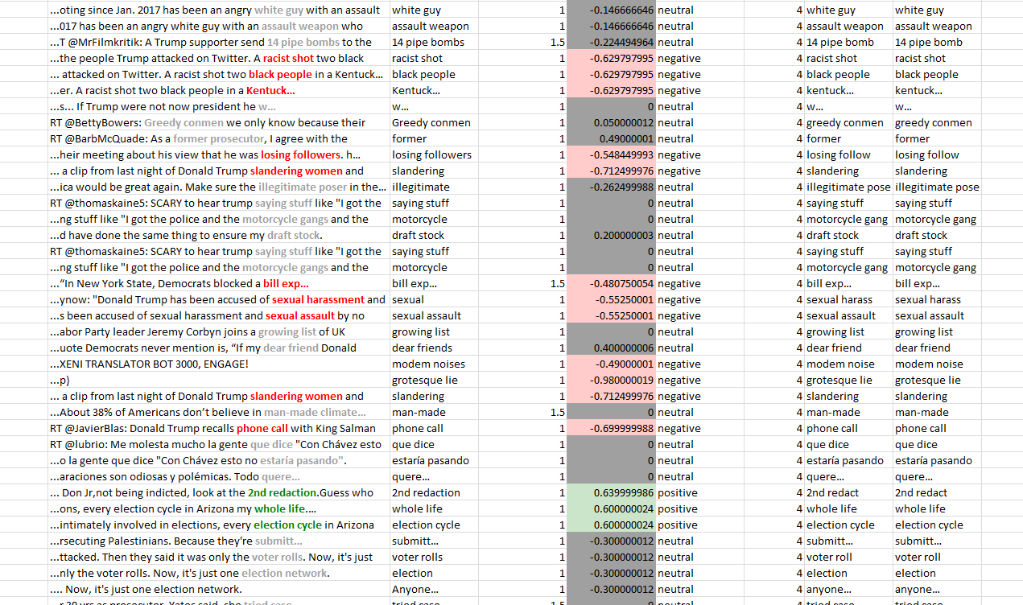
Semantria Sentiment Analysis Result
Notes:
Semantria does this breakdown of negative, neutral and positive based on different iterations by phrase detail, theme detail, entity theme detail and query category detail. As you can see in this view, negative phrases are highlighted and the tweet is captured as negative sentiment.

Slide 12
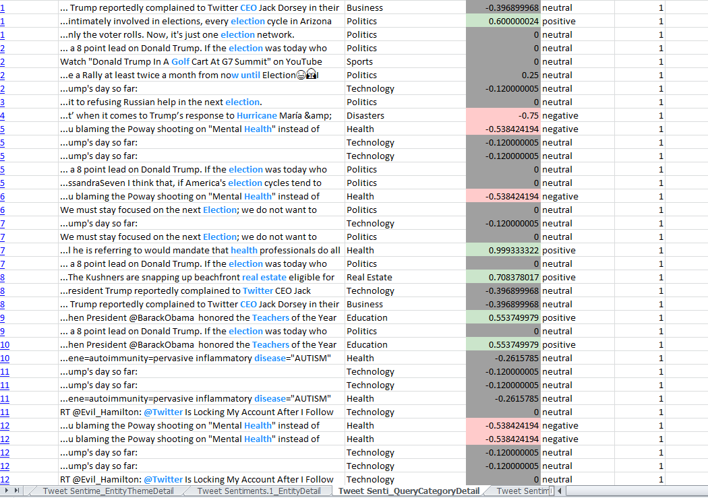
Semantria Sentiment Analysis Result
Notes:
This screenshot captures classification by query category detail.

Slide 13
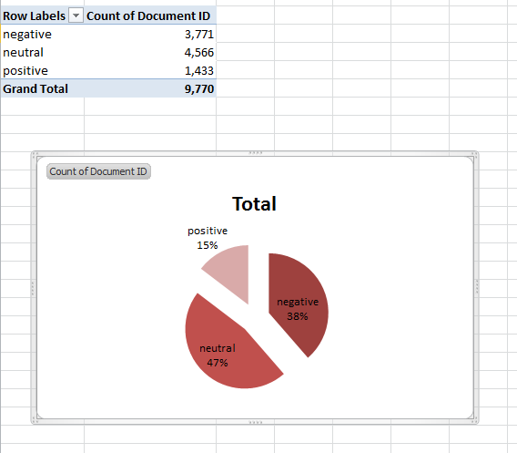
Result Set
Notes:
For the 9,770 tweets I extracted, here is the data set. About 47% of the tweets are classified as neutral, 15% as positive and rest, 38% as negative.

Slide 14
Outcome
This was an interesting project and I learned a lot about data crawling, data collection, and running sentiment analysis.
Output – As I mentioned, I don’t think the amount of data I was able to collect with free version would show any trend of actual sentiments.
This is more of a proof of concept and can be expanded with paid version subscription for NodeXL and Semantria.

Slide 15
Future Direction/ Reference
Paid version subscription to continue detailed analysis.
Classify Tweets, Re-tweets and mentions in separate bucket for individual analysis of these categories.
Reference: Visualization analyzing Tweets from Trump:
https://medium.com/swlh/analyzing-trumps-tweets-5368528d2c90

Slide 16
    Thanks!!

